Slide 1
A Survey of South American Lizards Biodiversity and Ecological

Slide 2
Introduction
South America is home to a diverse range of lizard species, each with its unique characteristics and adaptations to the various habitats found across the continent. This research explores the fascinating world of South American lizards, highlighting the unique characteristics, habitats, and ecological significance of three remarkable species.

Slide 3
The Sphaerodactylidae family consists of small geckos known as dwarf
South America is home to an incredible diversity of lizards, with over 1,000 species found across the continent. This article provides a brief overview of some of the most notable lizard families and species found in South America, including the Green Iguana.

Slide 4
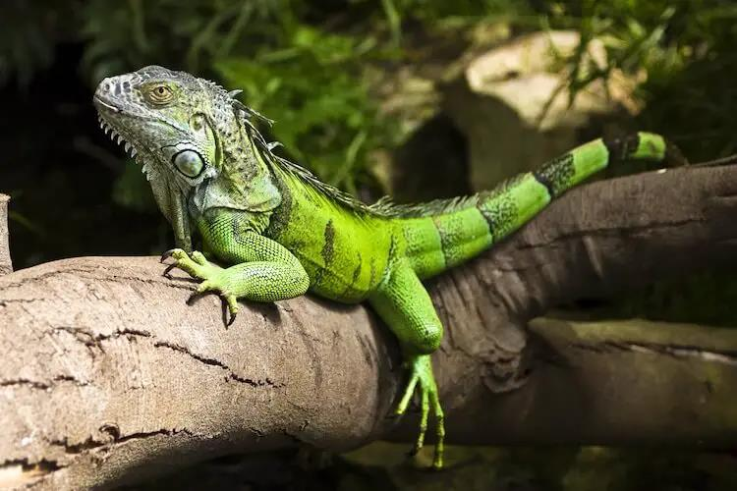

Slide 5
Caiman Lizard Dracaena guianensis
The Caiman Lizard is a captivating reptile native to the tropical regions of South America. The Tepui Lizard is a captivating and unique reptile inhabiting the Tepui plateaus of South America.

Slide 6
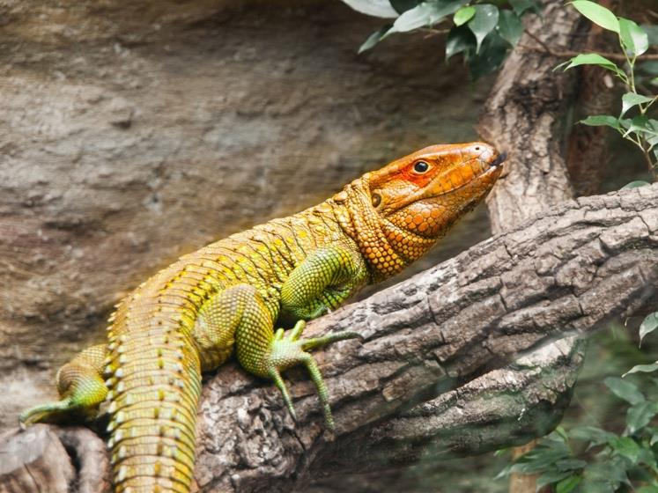

Slide 7
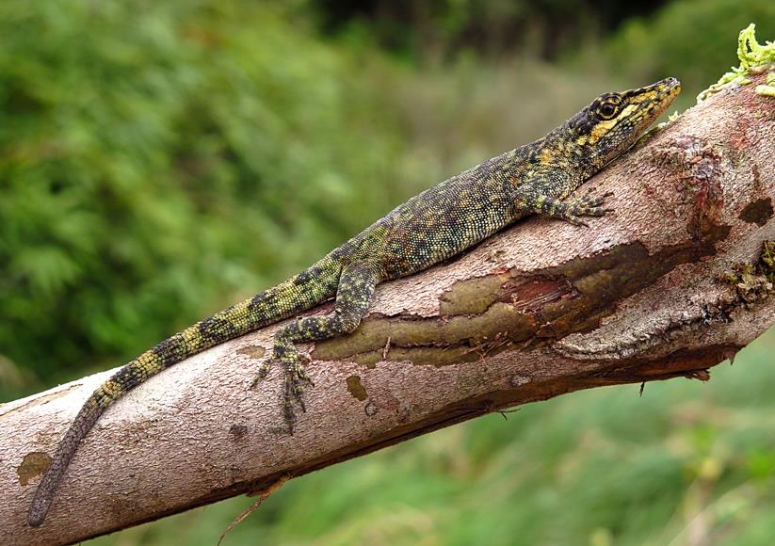

Slide 8
Threats and Conservation
The Green Iguana, Caiman Lizard, and Tepui Lizard are three of the most fascinating and diverse species of lizards found in South America. These captivating creatures face various threats, including habitat loss, illegal pet trade, and climate change, which highlights the need for conservation efforts to protect them and their habitats.

Slide 9
numerous threats such as habitat loss climate change and illegal trad
South America is home to an array of unique lizard species that play vital roles in their respective ecosystems. Threats such as habitat loss, climate change, and illegal trade require responsible research, education, and community involvement to conserve these reptiles and their habitats.

